Slide 1
Extending Education Application for General Education Standards

Slide 2
Introduction
The purpose of our project is to build a Mathematics learning application for 8th grade Math General Education Standards.
The application is switch accessible making it universal design.
All students can access using either the touch screen or switch.

Slide 3
Design guidelines.
Provide multimodal support
Aim for simplicity
Support visibility
Support one handed interaction
Refrain from making interface childish
Keep the number of steps minimal

Slide 4
Application Features

Slide 5
I. Easy Learning & Improving LR, and AT
Logical Reasoning and Analytical Thinking
How the app made easy to learn?
Student difficulties based on research
1.Lack of fundamentals
2. Simply following formulas without knowing how it derived

Slide 6
Based on these problems, picked 3 Modules of 8th Grade Math General Standards:
Rational/Irrational numbers
Pythagoras Theorem
Formulas (Volumes, Areas, Perimeter, Circumference, etc.)

Slide 7
Each module consists of several levels (assumed 4) depending on increasing difficulty.
Level organization:
i. Random generation of question from stack of questions.
ii. Level 1&2 focuses on the module fundamentals.
iii. Level 3&4 are advanced and require level 1 & 2 fundamentals and LR.
User gets into next level only by answering percentage of questions correctly.

Slide 8

II. Entertainment Module
What is the purpose?
Continuous study
i. loose interest
ii. Get tired
Refreshment
After completion of every level, the user will be granted access to an entertainment module (i.e. a 2-5 minutes game such as Checkers, Fruit Ninja).

Slide 9
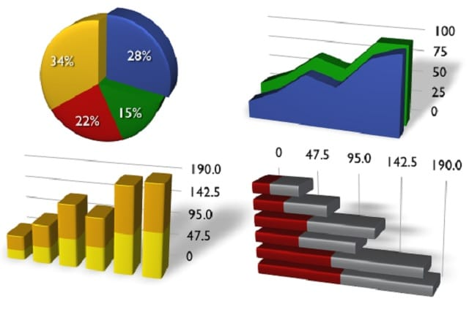
III. Accurate & Instant Feedback
What is the necessity of it?
i. Not find the weaknesses
ii. Would lack with analysis skill
iii. Not come up with better strategy
Boost the performance
Help instructors to identify student difficulties and to introduce new method to solve problem.

Slide 10
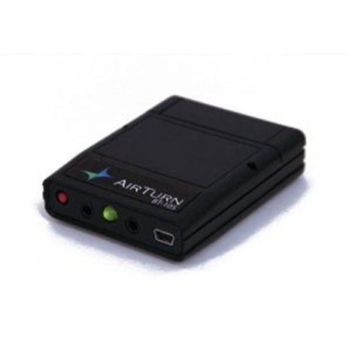
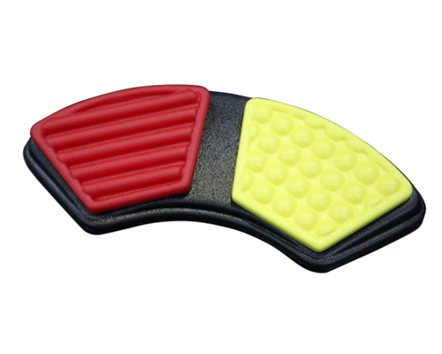
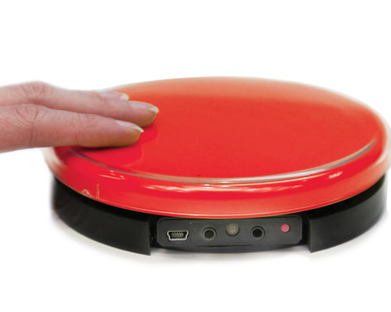
IV. Switch Accessibility
Two reasons to add this feature to our app:
Issues with touch sensitivity level
Support handicap/physical disability users
Transceiver
Double Switch
Single Switch

Slide 11
Switch Operation
By connecting one or two bluetooth switch devices to the tablet the student can manipulate the quiz section of the application. The manipulation will differ based on how many switches are connected
i. One switch will act as a selector. After the question is displayed a box highlighting the current question choice will scroll over the answers until the student actuates the switch to select their answer.
ii. The second switch adds the option to scroll through answers as the student wishes. When the second switch is actuated the highlighted box will move to the next option. The highlighted box will wrap around until the student actuates the first switch to make their selection.

Slide 12
Other Features
Reading questions through voice
Sound based navigation support
Application oriented Hint to the question
Calculator support
Instant summary

Slide 13
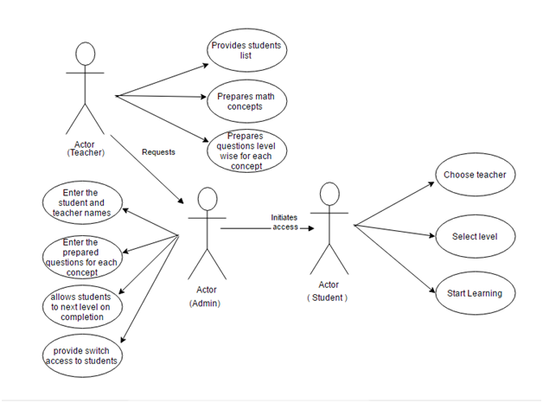
Use Case Diagram

Slide 14
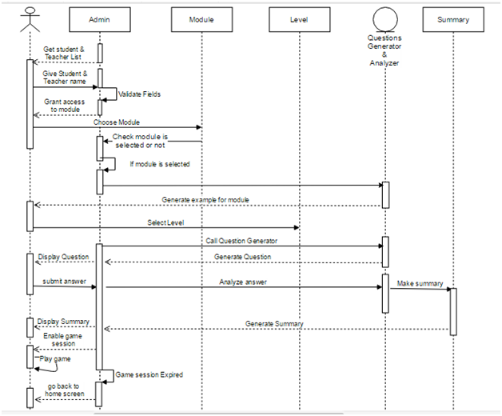
Sequence Diagram

Slide 15
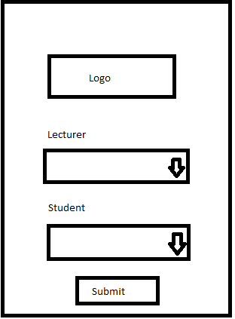
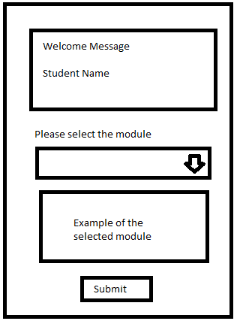
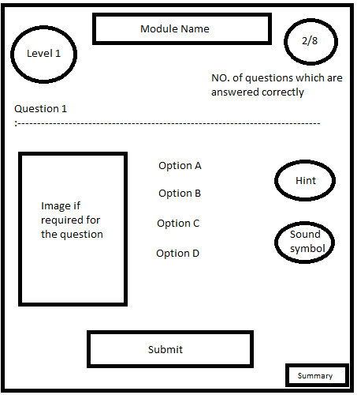
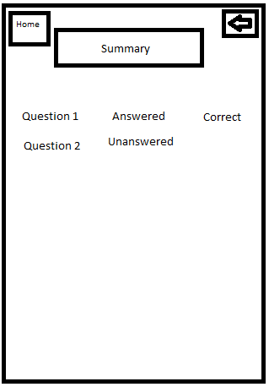
Module layout/flow

Slide 16
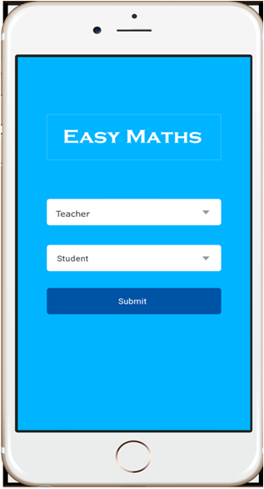
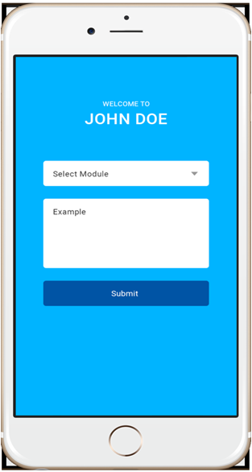
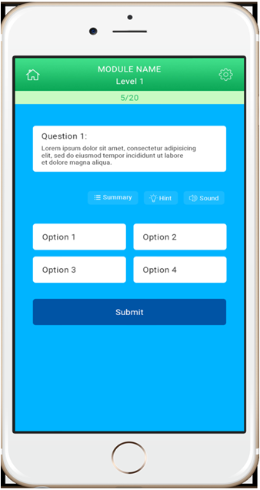
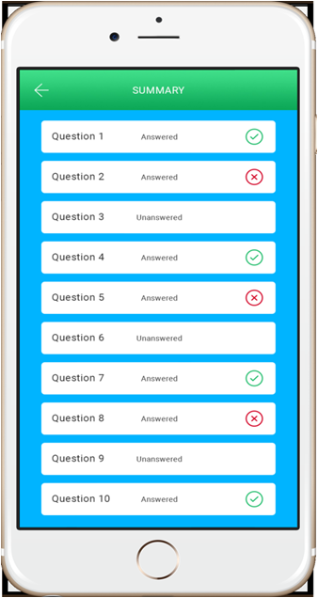
Sample screens

Slide 17

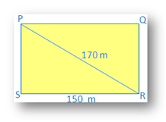
Sample Questions
Find the missing measure to the nearest tenth.
a. 6
b.48
c. 8.9
d. 6.9
Hint: Solve 8^2 = x^2 + 4^2
2. Find the perimeter of a rectangle whose length is 150 m and the diagonal is 170 m.
a. 350 m
b. 460 m
c. 500 m
d. 240 m
Hint: Perimeter of the rectangle = 2(length + width)

Slide 18
If you have any questions or comments please don’t hesitate to share your thoughts with us!

